Slide 1

English Department
BGE Literacy

Slide 2
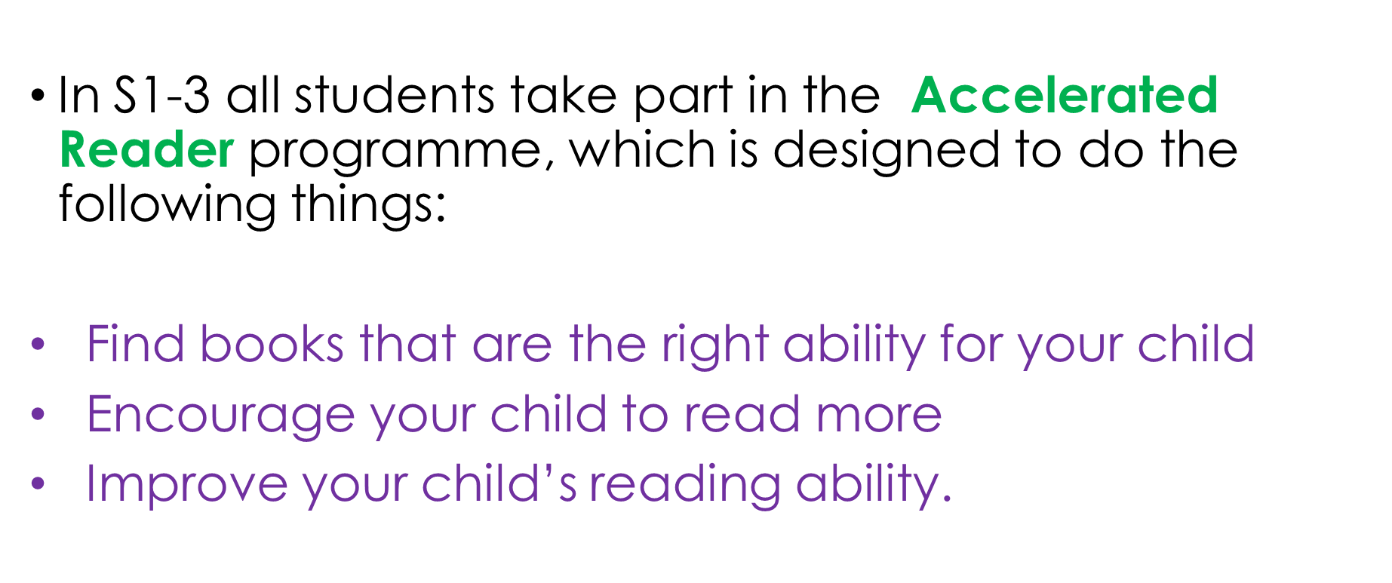
Accelerated Reader

Slide 3
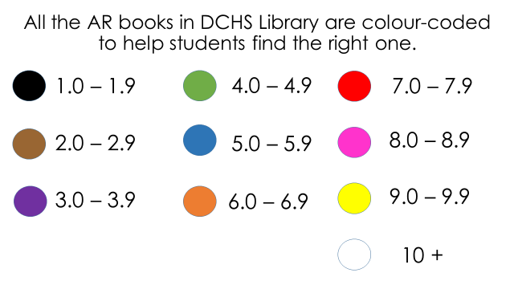
How does AR Work?
After completing a STAR reader test pupils are given a range of colours which match their current reading age.
A new STAR test takes place at regular intervals, so students can see improvements in their reading ability, but also choose more challenging books.
Designated library period each week in English to read, discuss and assess their progress

Slide 4
How can you help?
Model reading at home. This could look like you reading your own book whilst they read.
All reading is literacy... Audiobooks in the car, watch the film with subtitles/read the synopsis of a film together, get your child to help you with reading recipes aloud.
If your child is hesitant to read, ask them to read their book to a younger sibling, pet or object.
No matter what, don't tell your child that you didn't read.

Slide 5



Study of Texts

Slide 6
How can you help?
Ask them questions about what they are reading in class, specifically who are the characters? What are the characters like? What's happening in the text so far? What bit have they most enjoyed? What do you think is going to happen next in the story?
Watch or discuss or research real life events that link to the texts they are reading... e.g. The Hunger Games, THUG, Christmas Carol.
If they seem particularly interested in a class text, feel free to get in touch with the department and we can recommend other books and stories.

Slide 7
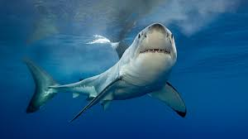
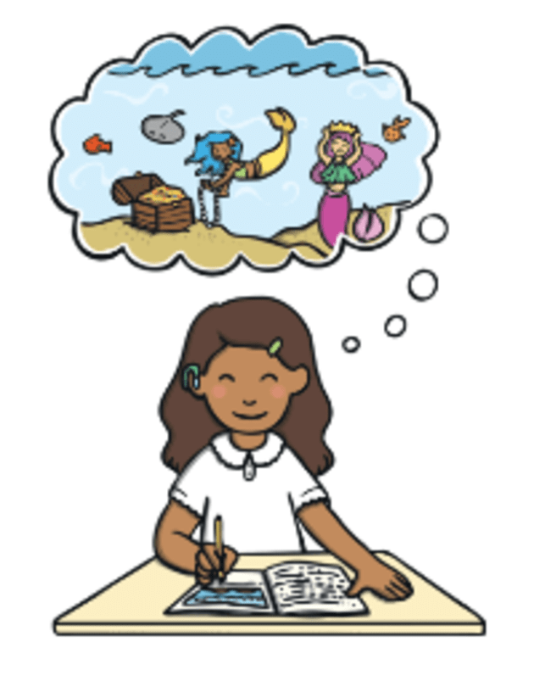

Writing Skills

Slide 8
Literacy crosses boundaries..
When they are completing homework for any homework, if you can spend a couple of minutes helping them check over it for basic mistakes, this all helps to build healthy habits around writing.
At any opportunity, try any of these to help build their dexterity and motor skills:
  Drawing pictures, sketching, colouring in the lines
  Writing stories, letters, notes, shopping lists
  Cooking – chopping, measuring, mixing, baking
  Games with small objects such as chess, throw and catch, jigsaws etc.

Slide 9


Listening and Talking

Slide 10
Literacy crosses boundaries..
  Listening is a really important skill.
  Listen to audiobooks, podcasts and documentaries as often as you can. Talk about what you've listened to.
  DO NOT LET THEM OPT OUT OF CLASS TALKS. These are super important for their confidence, their resilience, their ability to communicate effectively and their overall result at National 5.

Slide 11
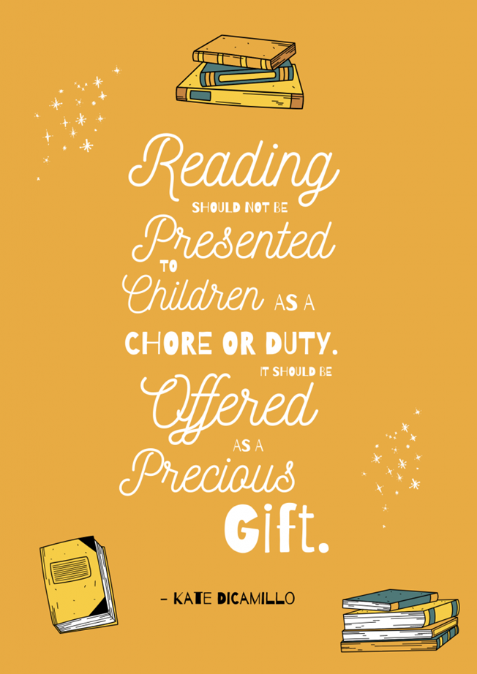

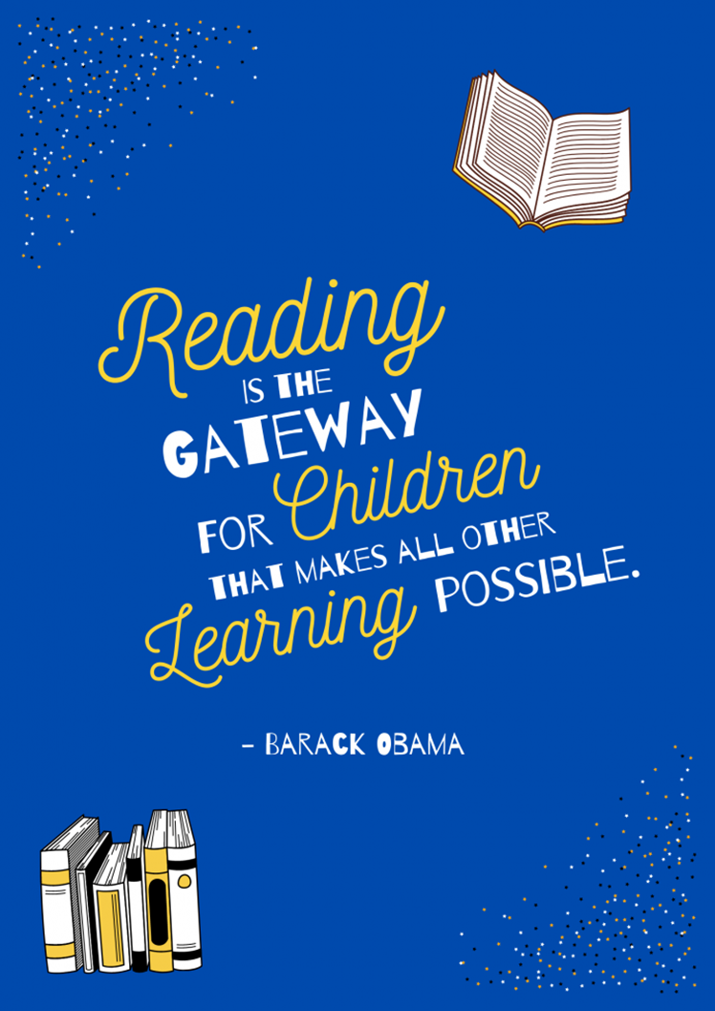
Any Questions?

Slide 12
