Slide 1
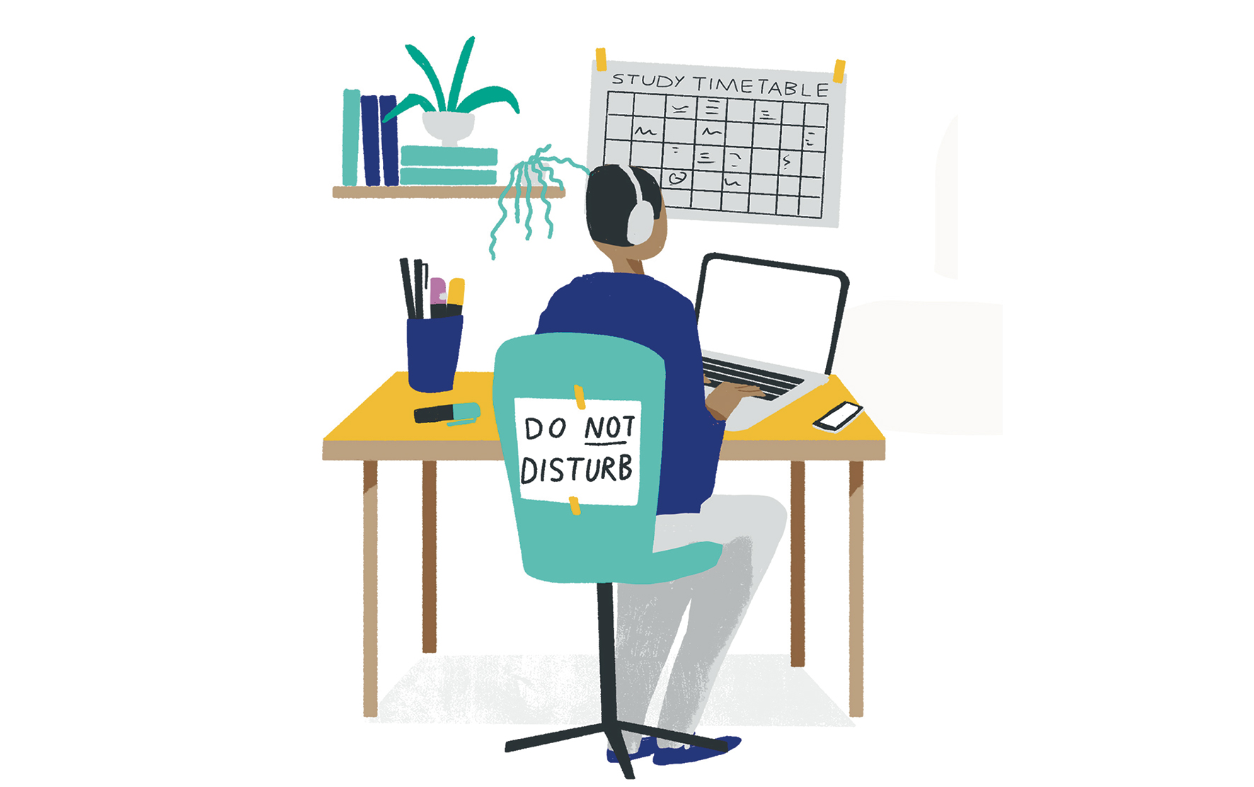
Supporting your Child’s Revision at Home

Slide 2
Why Revision at Home is Important
Revising at home is vital for students because it;
Solidifies key learning outcomes covered in classes
Strengthens long-term memory
Regular revision directly leads to better grades
Improves familiarity with subject-specific vocabulary, making subsequent lessons easier to follow.
Builds independent time-management skills that a standard classroom setting cannot replicate.

Slide 3
When do students start?
As soon as possible from August:
It's important to start these good revision habits now and study consistently through the year rather than leaving it all until after Christmas or after Easter- there are lots of coursework deadlines after Christmas so it's vital to revise what you do in class as you go along.

Slide 4
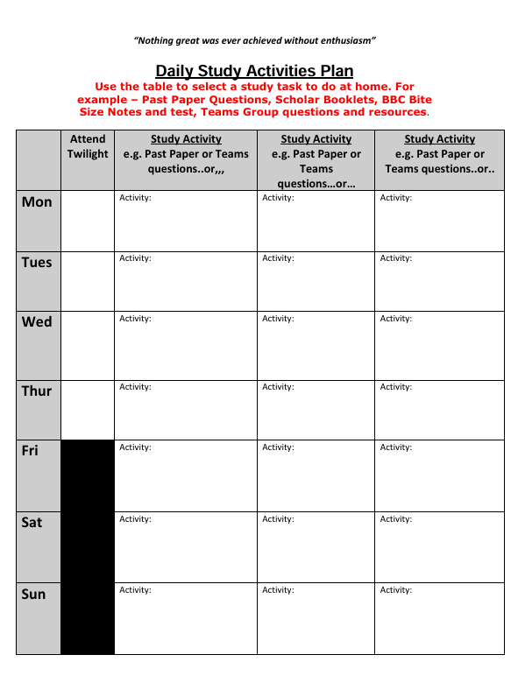
Organisation of Study Space and Resources
Create a “Study Zone”
A desk or table with only the essentials: notebook, pen, highlighters, laptop, water.
Remove distractions (gaming controllers, unrelated books, clutter).
Keep phones out of reach unless needed for study.
Organise study resources– have all your notes in one place and bundled into the different subjects
After creating the space – now time needs to be set aside for revision
Ask your subject teacher for a study jotter
Make a study planner – see example

Slide 5
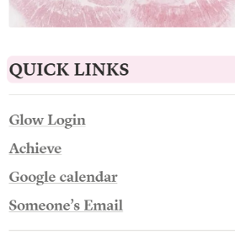
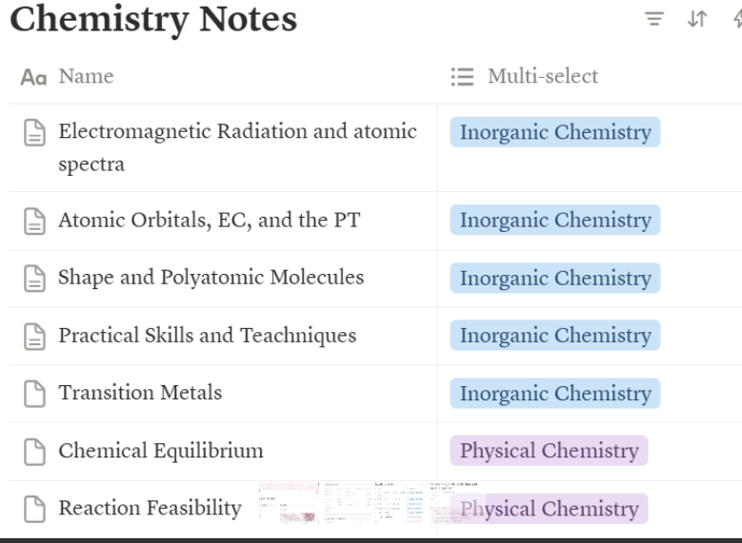
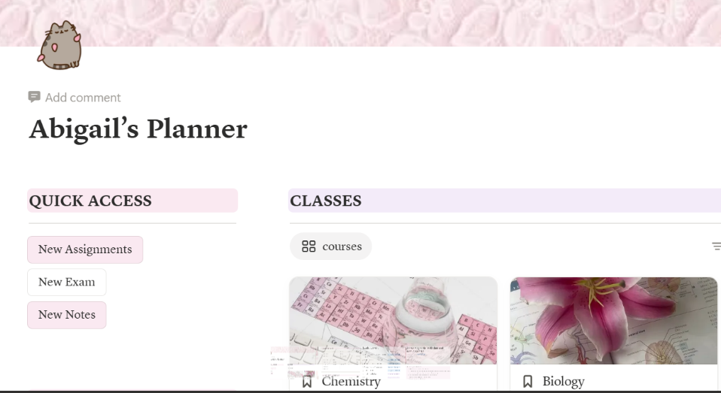
Organising your Summary Notes and Links Electronically
Some students prefer to type up summary notes and definitions etc. This can be done electronically

Slide 6




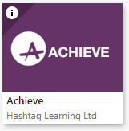

Where to Find Resources
Teams
BBC Bitesize
ACHIEVE
Past Paper sites (JABChem for all the sciences, Teams groups for all subjects, SQA Website for all subjects)
These resources can be used to help with Revision of knowledge and with Challenging of knowledge.

Slide 7
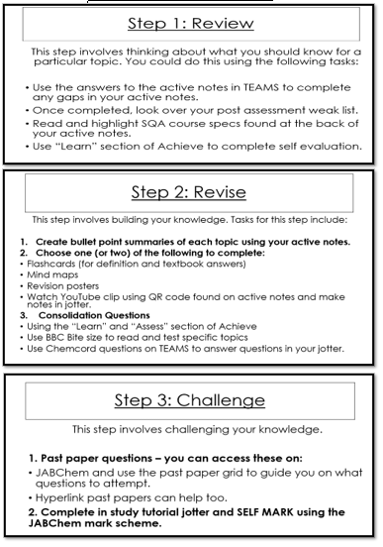
Resources – How to Use Them
Revision System: Review/ Revise/Challenge
Review – All students should have a
Weak list or feedback from any assessment
they have sat. This tells them their key areas of
strength and key areas to work on.
2. Revise – From the review students start to build knowledge by using revise resources (Flash Cards, Mind Maps, Summary notes) using their notes, ACHIEVE and websites recommended by subjects – see handouts
3. Challenge - After ‘Revision’ it is time to challenge this knowledge – Past Papers are the best resource to challenge knowledge as this is the standard students will be assessed on.
All study/Revision should be written in student’s Study Jotter. This gives evidence of revision and allows for tracking of revision progress.

Slide 8

Managing Your Study at Home
Don’t set yourself a set time to study e.g. 2 hours.
Select an ACTIVITY to do a like a set of flash cards, a set of summary notes or a set pf past paper questions linked to key areas….then focus on finishing the activity rather than constantly looking at how much revision time you have left to go.
1
Take breaks during your studying- humans can concentrate well for 40 minutes and then need a 5-minute break, ideally to get up and move (not reach straight for your phone).
2
Promise yourself a reward to motivate yourself, e.g. you can watch TV for 30 minutes when you've studied for 2 hours. (DON'T try to do both at once!)
3

Slide 9
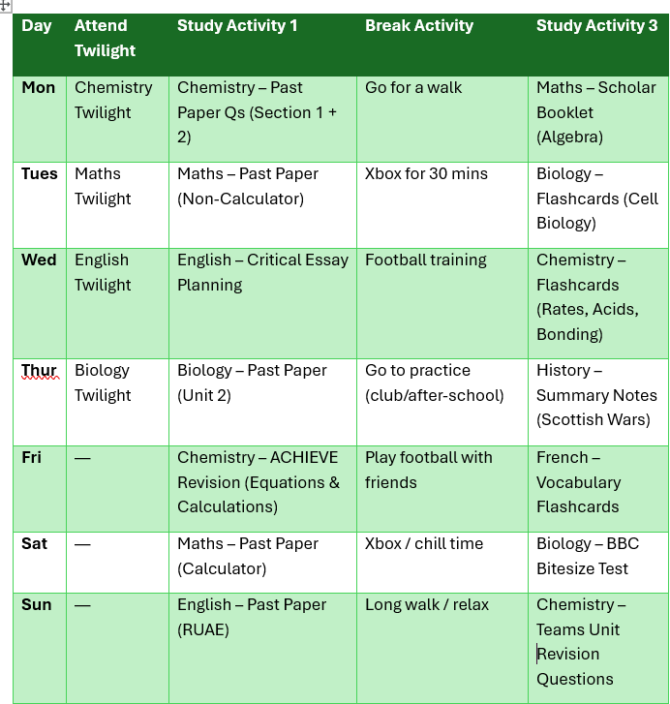
Example of Study Plan – Generated by AI Co-Pilot

Slide 10
S6 Ambassadors – Hints and Tips
Organising space to study
Making Summary Notes – see handout
Flash Cards – where to get them/How to make them – see handout
Creating time to study – Hints and tips – see handout
How to organise your notes into subjects electronically – see Science Ambassadors

Slide 11
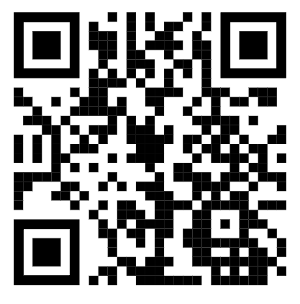
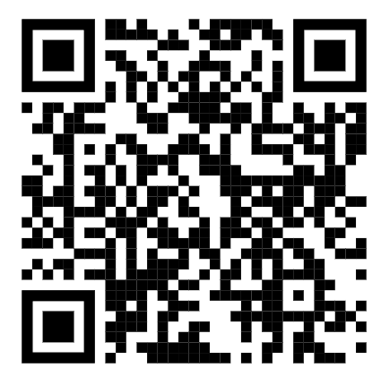
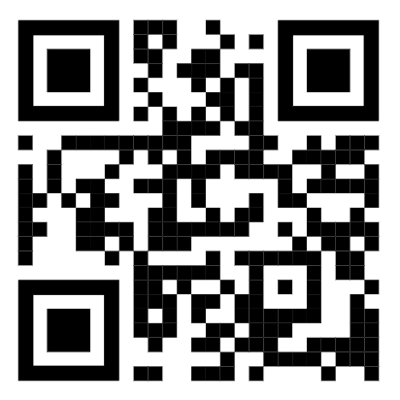
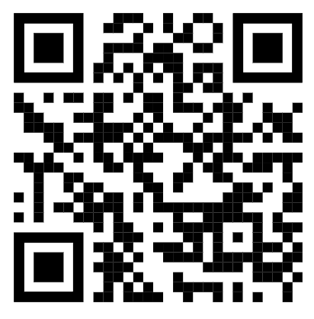
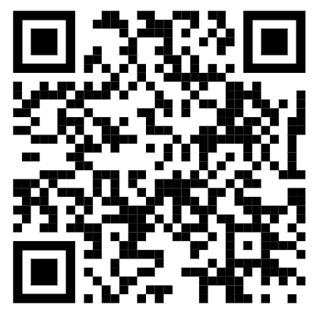
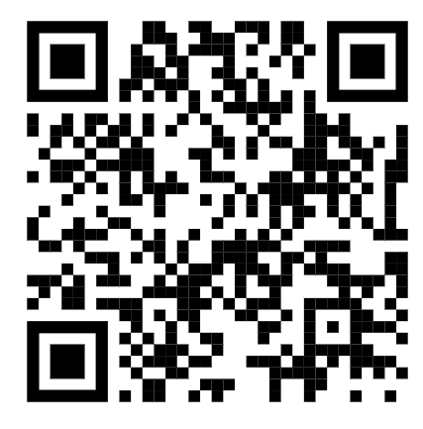
Links to General Web sites
Website | QR Code
Qualifications Scotland
ACHIEVE
JABChem
QUIZLET Flash Cards Generator
BBC Bitesize National 5
BBC Bitesize Higher

Slide 12
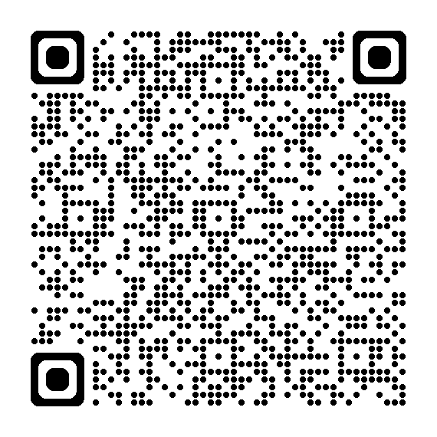
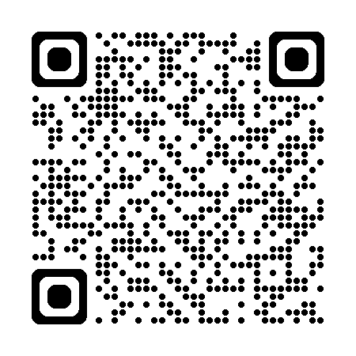
More website links
Website | QR code
Memrise- learning information by heart
Wordwall- language learning website

