Slide 1
Staff
Miss Lauren Evans – PT – PE
Mrs Lauren Devlin – Pastoral Support Lead/PE
Miss Samantha Luke – PT – Music & Drama
Mr Dean Tearney – Head of House

Slide 2
Short term memory retrieval –
Dean Tearney
The most common questions or statements from students in S1-3
How do I study for this?
When will I use this?
How do you expect me to remember all of this?
Will this part be in the exam/portfolio?
Its fine, I’ll crash 2 weeks before the exam
It doesn’t matter until S4

Slide 3
Its all in the preparation.
Habit and routine are key
Find something that works for you
All too often you may hear from a closed bedroom door ‘I am studying’
Do they know how to study?
Habits – If it’s a quiet house, study in the dining room or somewhere where parents/carers can see you
If you do study in your room – give yourself breaks; step out of the room; be productive

Slide 4

Everyone is different – we all learn in different ways.
Consolidating your learning early is the key to retaining and joining the dots.
Take 10 minutes per subject (there will normally be a core subject like PSE or PE where studying isn’t required)
Period 1 – Science (10 mins)
Period 2 – English (10 mins)
Period 3 – Maths (10 mins) etc…
You consolidate in only one hour. In the 10 mins per subject you write down everything you understood from the lesson and highlight parts you didn’t. You can then either use that lack of understanding as part of a longer study plan or ask the teacher to explain more.
Habits like these build confidence, skills and knowledge.
It doesn’t feel like a chore
1 hour per night is enough to build learning
Creates a foundation for senior phase

Slide 5
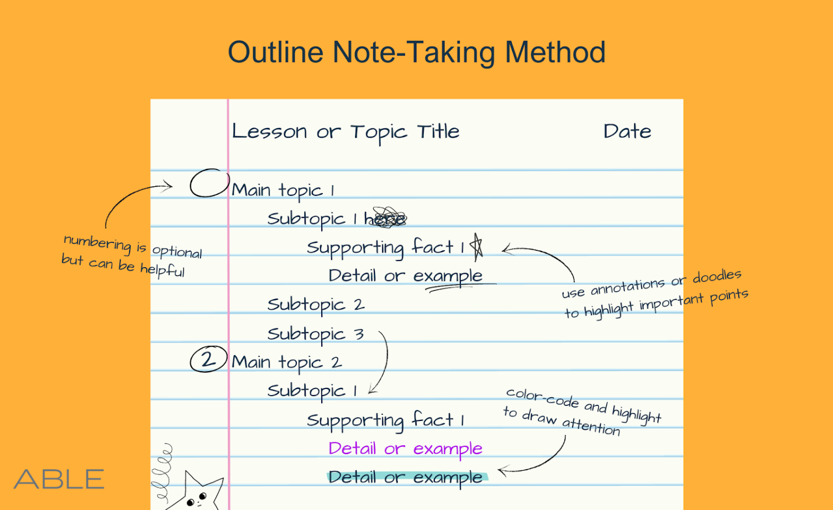
Revision Techniques
Acronyms: A word formed from the initial letters of a series of words (e.g., "ROYGBIV" for the colors of the rainbow).
Acrostics: A sentence where the first letter of each word stands for something (e.g. "Every Green Bus Drives Fast" for the notes on the lines of the treble clef in Music).

Slide 6
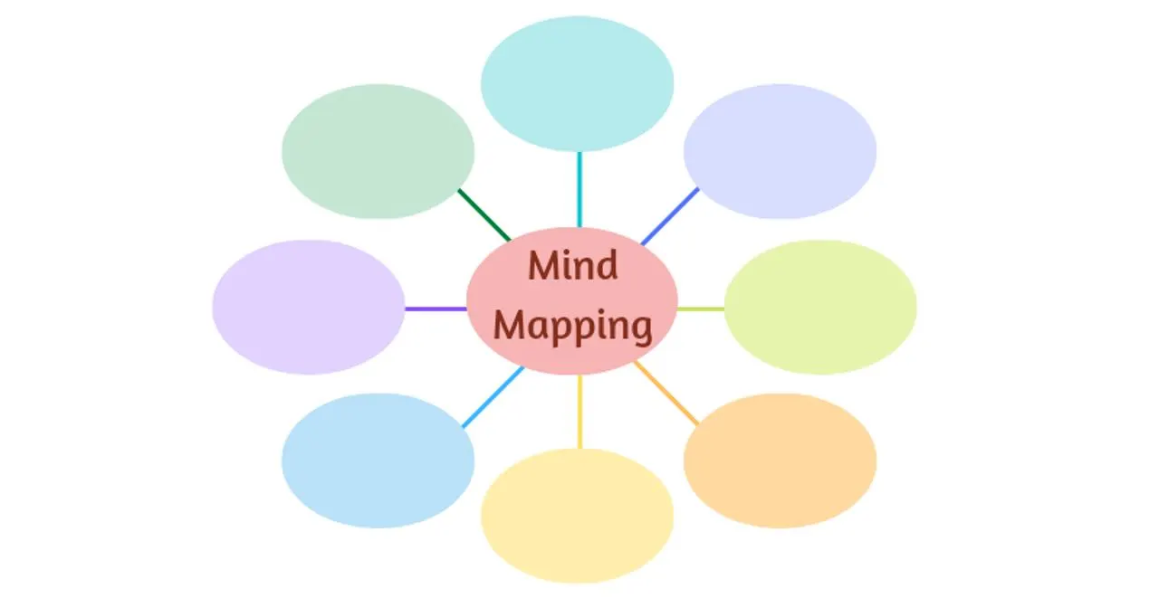
Mind Maps

Slide 7
What is a Mind Map?
A mind map is a visual diagram that starts with a central idea and branches into key topics, then subtopics.
It uses colour, mages, keywords and connections to help your brain organise information.
A central idea or title in the middle
Branches for main themes
Sub-branches for detail
Simple keywords
Colours and icons

Slide 8
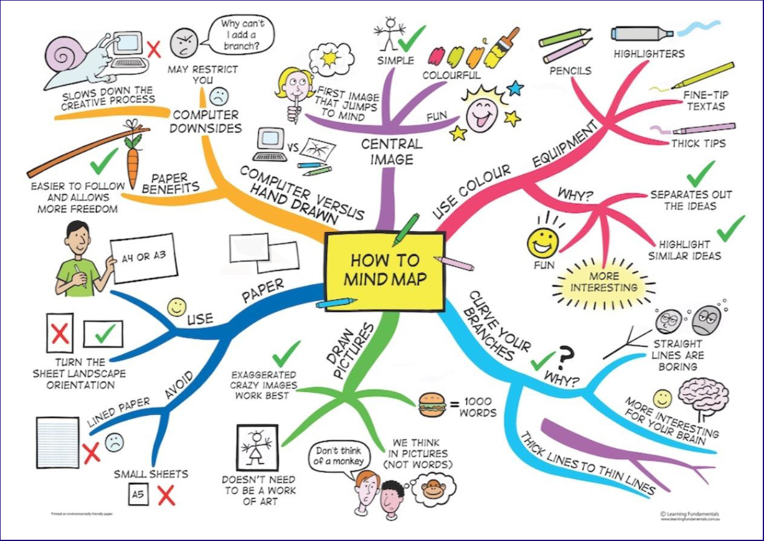

Slide 9
Why are Mind Maps Useful?
Makes big topics feel manageable by breaking them down
Stimulates memory – your brain remembers images and colours more easily than text
Helps you see connections between ideas
Saves time – quicker than rewriting notes
Useful for planning essays, reports, or presentations
Great for last‑minute revision because everything is on one page

Slide 10
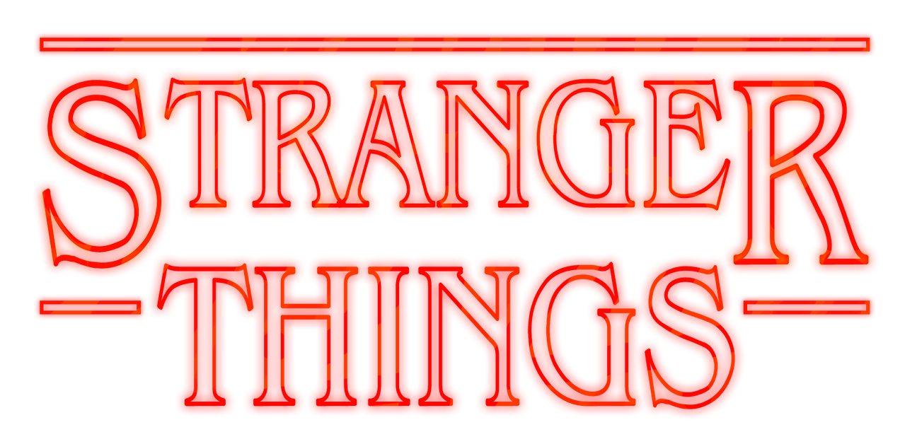
Friendship
Fear
Good Vs. Evil
Eleven
Mike
Dustin
Vecna
Themes
Characters
Spending time with friends
Plot Elements
The Upside Down
Hawkins Lab
Mind Flayer
Iconic Moments
Regular exercise
Running up that hill scene
Demogorgon fight
Limiting screen time
Settings
Hawkins
School
Byers House

Slide 11

Friendship
Courage
Good Vs. Evil
Identity
Sacrifice
Harry
Hermione
Ron
Voldemort
Dumbledore
Snape
Characters
Themes
Spending time with friends
Plot Elements
Horcruxes
Deathly Hallows
Quidditch
Triwizard Tournament
Battle of Hogwarts
Iconic Moments
Regular exercise
Harrys first quidditch match
Cahmber of secrets opening
Dumbledore Vs Voldemort duel
Yule Ball
Snapes 'Always' memory reveal
Limiting screen time
Settings
Hogwarts
Diagon Alley
Hogsmeade
Ministry of Magic
PrIvet Drive

Slide 12
Mind Maps Practice
Choose a topic you enjoy:
TV Show
Sport
Video game
Musician or Band
Film Franchise e.g. Marvel
A hobby e.g. reading/baking

Slide 13
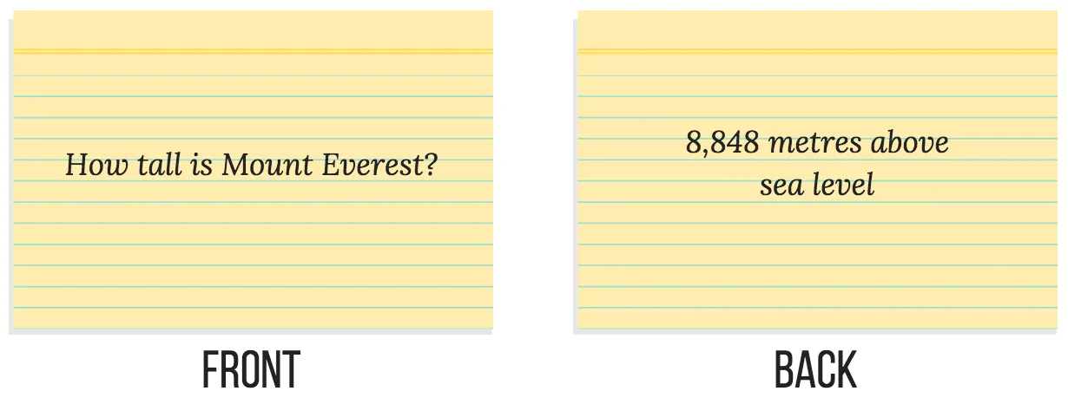
FLASH CARDS
Flash cards are short summaries of information/question and answer cards to help you revise.
On one side, write the question.
On the other side write the answer.
Use them to test yourself or use them with a family member/friend.

Slide 14



Additional Resources
School Clubs - Deans Community High School

Slide 15
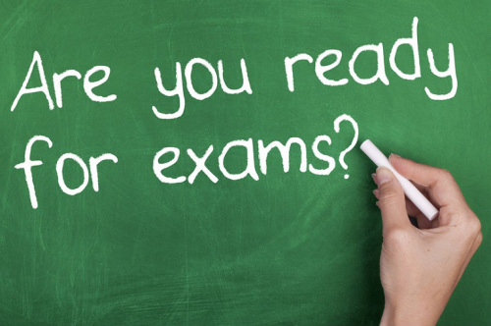
S1-3 STUDY SKILLS & SUPPORT
Exam/Test Stress
Sleep
Nutrition
Exercise and fresh air

Slide 16
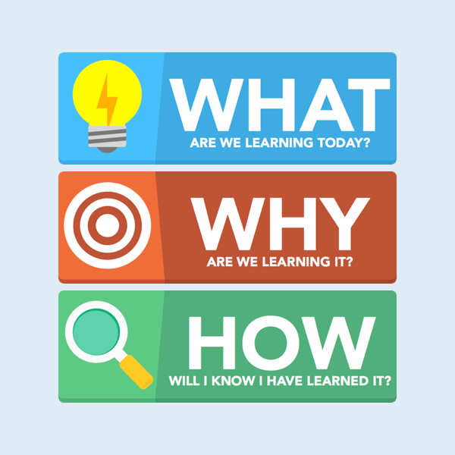
What, Why and How
WHAT – the role of stress, sleep, nutrition, and exercise during exams
WHY – to support your & your child’s well-being during BGE and SP.
HOW – you will be able to identify steps you will take to support your well-being during school & exams.
Activity:
What is your biggest challenge during exams?

Slide 17

Understanding Stress
Stress is a natural response to pressure, but too much stress can affect how we think, feel, and perform.
Stress can cause tension, worry, feeling overwhelmed and impact concentration.
Short-Term Effects: Anxiety, panic, sleep disruption.
Long-Term Effects: Reduced immunity, lower performance, burnout.
Activity
Close your eyes, take a deep breath in for 4 counts, hold for 4 counts, and slowly breathe out for 4 counts. Do this 5 times.
Simple exercises like this can help calm stress.

Slide 18

The Power of Sleep
When you are stressed, it’s easy to neglect sleep, but good sleep is crucial for memory, concentration, and problem-solving. Sleep helps with memory consolidation, mood regulation, and cognitive function.
Recommended sleep for teenagers: 8–10 hours per night.
Tips for a better sleep:
Set a regular bedtime.
Avoid screens 30–60 minutes before bed.
Create a calming bedtime routine (reading, relaxing music)

Slide 19
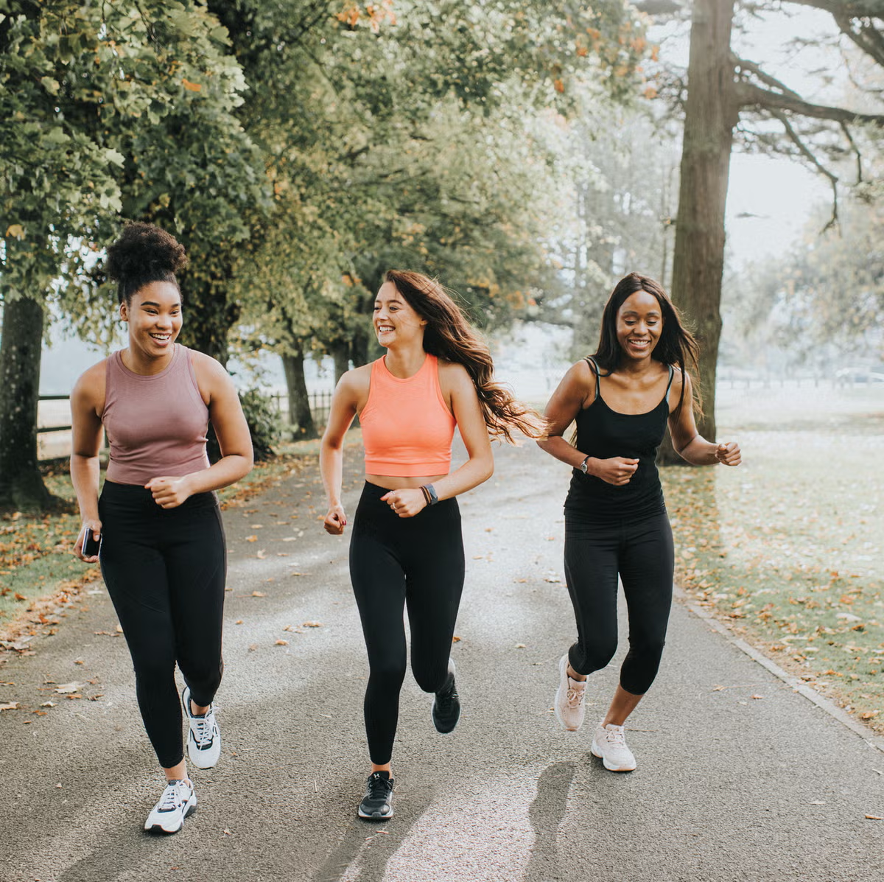
Exercise, Fresh Air
& Physical Activity
Exercise is a great way to reduce stress and improve your mood. You don’t have to go to the gym—simple activities like walking, stretching, or dancing are effective.
Fresh air and outdoor time is especially important – leave your window open during study and at night.
Benefits of exercise:
  Boosts endorphins (natural mood lifters).
  Reduces stress.
  Improves focus and cognitive function.
TIP – during study, take regular 10-minute walks, run up and down the stairs a few times or do quick exercises.

Slide 20
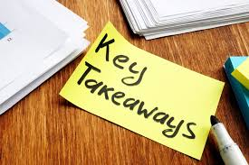
Wrap Up, Practical Tips and Takeaways
Final Tips:
Stay organized and create a study schedule.
Take breaks—study for 30–45 minutes, then take a 5-10 minute break.
Don’t forget to reward yourself for progress (a treat, a fun activity, etc.).
Activity:
What’s one thing you’re going to try from today’s session to improve your exam preparation?

