Slide 1


P7 - S1
Transition
2026-27

Slide 2

Our school day
Monday - Thursday
Period | Times
Period 1 | 8.35am to 9.25am
Period 2 | 9.25am to 10.15am
Period 3 | 10.15am to 11.05am
Break | 11.05am to 11.20am
Tutor | 11.20am to 11.35am
Period 4 | 11.35am to 12.20pm
Period 5 | 12.20pm to 1.10pm
Lunch | 1.10pm to 1.50pm
Period 6 | 1.50pm to 2.40pm
Period 7 | 2.40pm to 3.30pm
Friday
Period | Times
Period 1 | 8.35am to 9.25am
Period 2 | 9.25am to 10.10am
Break | 10.10am to 10.25am
Tutor | 10.25am to 10.40am
Period 3 | 10.40am to 11.30pm
Period 4 | 11.30pm to 12.20pm

Slide 3
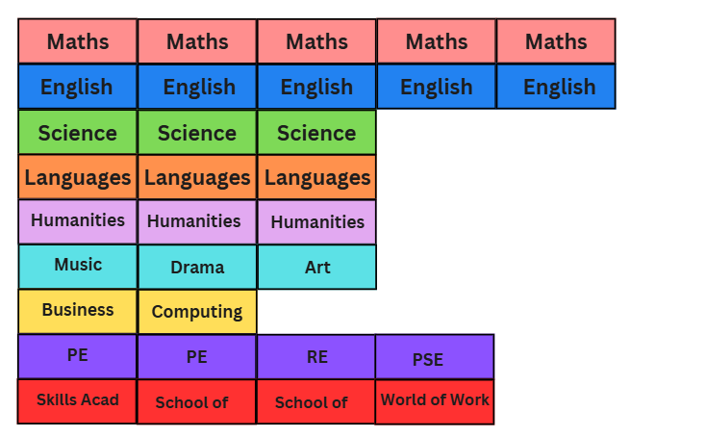
BGE Curriculum
The week is split into 32 periods
Each period is 50 minutes long (with the exception of P4)
Core subjects PE/RE/PSE.
Skills Development and elective opportunities

Slide 4

Skills Academy
This program takes place in 6-week blocks covering topics such as forensics, philosophy, media and money management.
It is designed to develop skills such as communication, collaboration, teamwork and leadership. These are important across the school and into post-school destinations.
Pupils are supported to identify skills and discuss how they use them.

Slide 5

School of...
  School of Football
  School of Netball
  School of Dance
  School of Philosophy
  School of Culture & Conversation
  School of Cookery
  School of Drama
  School of Music

Slide 6

World of Work
This is a new opportunity where students will develop competency in areas required for the world of work including:
Digital Literacy
Enterprise
Communication
Jobs of the future
They will also begin to build their personal skills and strengths profile using My World of Work.

Slide 7
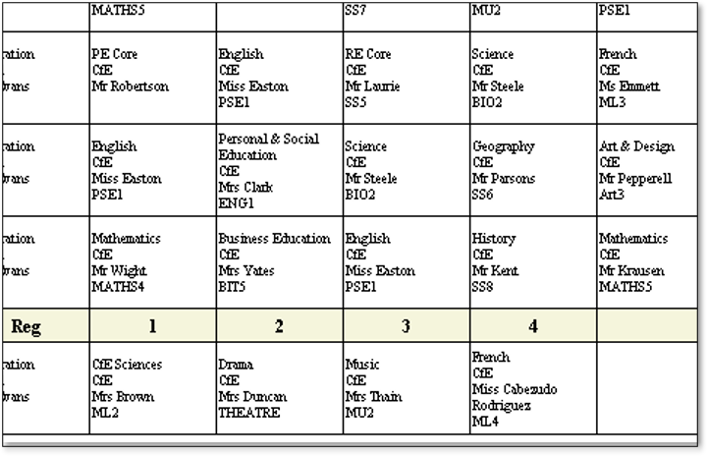
Timetable
How does this work?

Slide 8

Literacy
Literacy is a key focus of the work done during transition and across the BGE to build solid foundations for the Senior Phase.
Students in the cluster have participated in the reciprocal reading programme.
In S1 they will begin the Accelerated Reader programme.
Our English Transition sessions have focused on the set text "Ghost Boy"
Reading is a core part of the learning experience in Deans and supports achievement across the school.
Last year we gained the "Reading Schools Silver Award" accreditation

Slide 9

Numeracy
Deans CHS aims to build the capacity of our students to think mathematically – this has been a key focus area throughout our cluster over the past 2 years
During P7 pupils have participated in the Building Thinking Classrooms work led by our Cluster Numeracy Lead teachers.
In Maths, they will use these skills weekly.
Feedback from pupils so far shows that they enjoy maths lessons, feel they have developed critical thinking skills and most importantly have developed mathematical confidence.

Slide 10
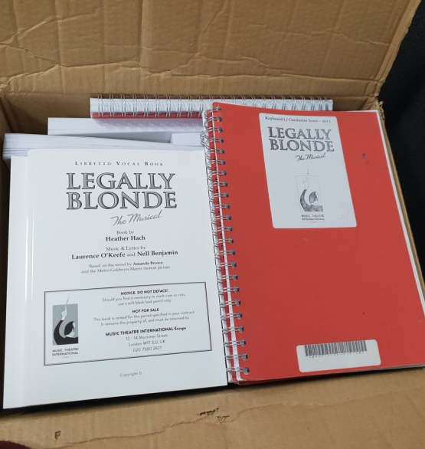
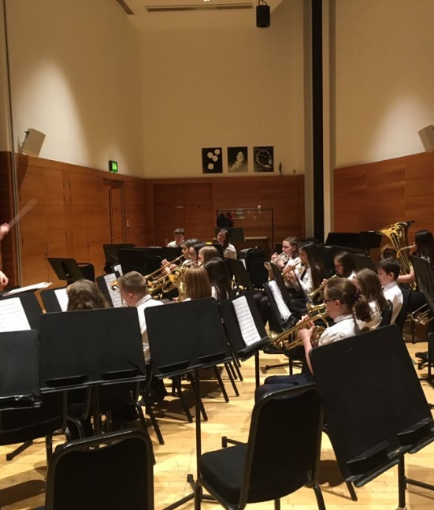
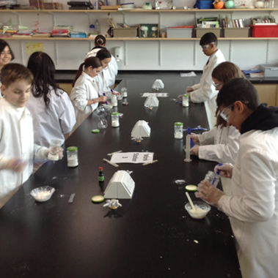
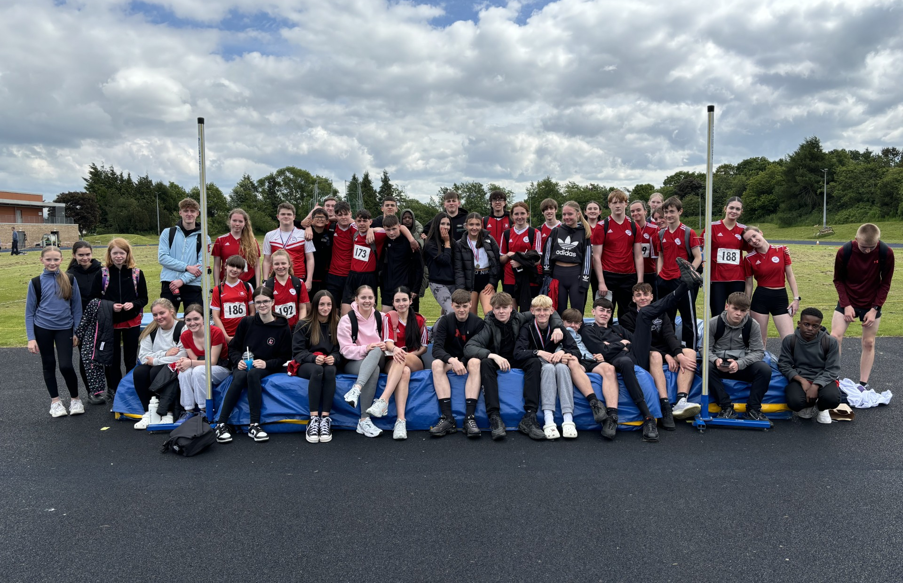
Extra-Curricular
The wider experience is a huge part of school life in Deans with opportunities such as:
School bands
Sports activities including sportathon
School shows and musicals
Science fair and Science club
Activities week
Leadership opportunities

Slide 11

Transition 3-day visits

Slide 12

Transition Visits
Monday – in primary (preparation for Tuesday).
Tuesday – come to school with their primary.
P1 in the theatre then follow normal timetable.
Wednesday – come to school on their own.
Follow normal timetable
Thursday – Come to school on their own.
Normal timetable in the morning.
P4/5 in the theatre and a special performance during P6/7
Friday – at primary

Slide 13
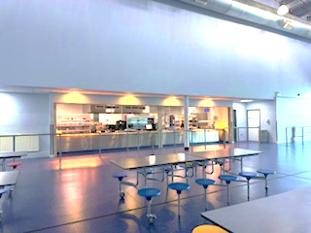
Lunches
Transition week
Primary schools have already identified pupils entitled to free school meals.
This year, P7 pupils may choose to have a school lunch during the transition visit (info on payment on next slide).
From August
School lunch or packed lunch. Money can be added via machines or online.
Fusion app available for pre-orders
S1 students are not allowed to leave school at lunch.

Slide 14

IMPORTANT INFO
Feel free to take a picture of the next slide :-)

Slide 15

Lunches
Students have been provisionally enrolled as
students of Deans CHS for their transition week.
Lunch cards will be provided on their first day of transition.
If your child would like to have a school lunch you should follow the steps below:
Log on to iPayimpact
Select Deans CHS alongside the current primary school
You should now be able to add funds to the secondary school account. Only add the amount you think will be required for the 3 days.

Slide 16

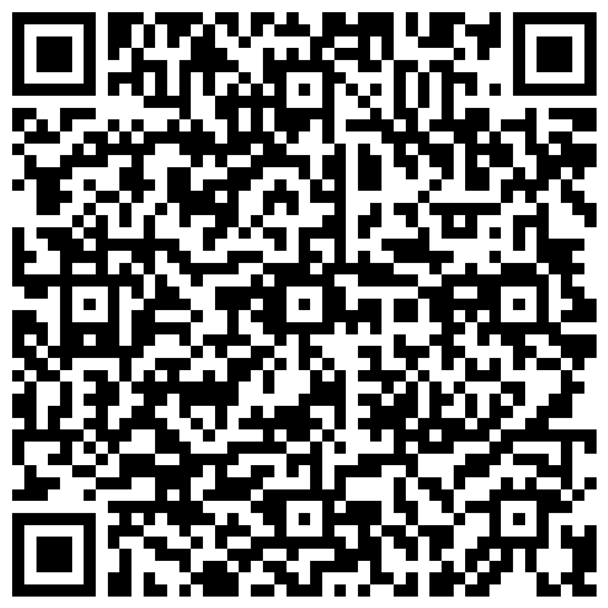
Pre-ordering Meals
Many thanks to those who have already completed the form.
This is to allow our catering staff to plan for the P7 students.
If you have not already done so, please complete the form using the link sent via group call or the QR code here.

Slide 17
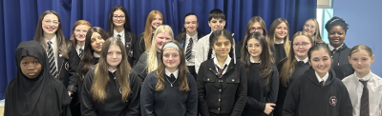
Uniform
Plain black trousers, skirt, jeans, leggings or smart shorts.
White shirt
School tie (junior and senior)
Black jumper of hoodie – plain black, school logo or very small logo if not the school logo.
Mostly black shoes or trainers
Blazer – optional

Slide 18

PE Kit
A full change of kit including
T-shirt, shorts/leggings/tracksuit
bottoms and a change of shoes.
Pupils must change for PE.
If you have PE period 1, you must
come to school in uniform and change
into PE kit.

Slide 19
IMPORTANT INFO
Feel free to take a picture of the next slide :-)

Slide 20

Medication
If your child requires medication to be kept in school, please discuss this with the primary school staff. This medication should be brought to Deans CHS on Tuesday morning and dropped off at the main reception.
In August, you are responsible for bringing this medication in. PSA staff will be available on the two INSET days.
Health care plans will be shared by the primary school.

Slide 21
IMPORTANT INFO
Feel free to take a picture of the next slide :-)

Slide 22




To recap...
Wear primary school
uniform on all 3 days.
Monday – In primary schools preparing for transition visits.
Tuesday – come to school with their primary class.
P1 in the theatre then follow normal timetable.
Wednesday – come to school on their own.
Follow normal timetable
Thursday – come to school on their own.
Normal timetable P1-3.
Theatre P4/5.
Expressive Arts performance P6/7.
Friday – at primary
Bring PE kit to change
if you have PE.
Bring a packed lunch or register on iPayimpact if ordering school lunch
(FSM will be provided)
Any medication to
be dropped off on
Tuesday morning

Slide 23
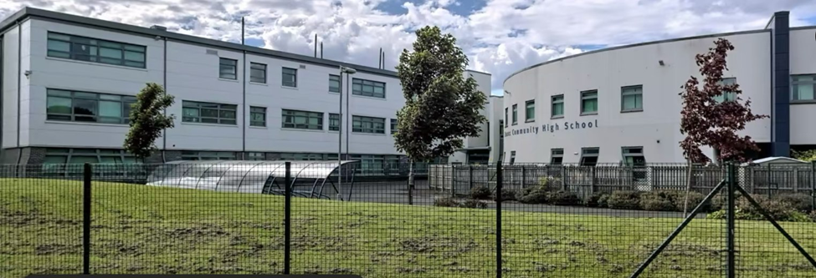
Deans Community High School
Pastoral Support

Slide 24

Tonight's Takeaways
Meet the team
How and when to contact the school (Phone/ Email/Groupcall)
Parents as partners (Attendance, Uniform, Concerns/Issues)

Slide 25
IMPORTANT INFO
Feel free to take a picture of the next slide :-)

Slide 26
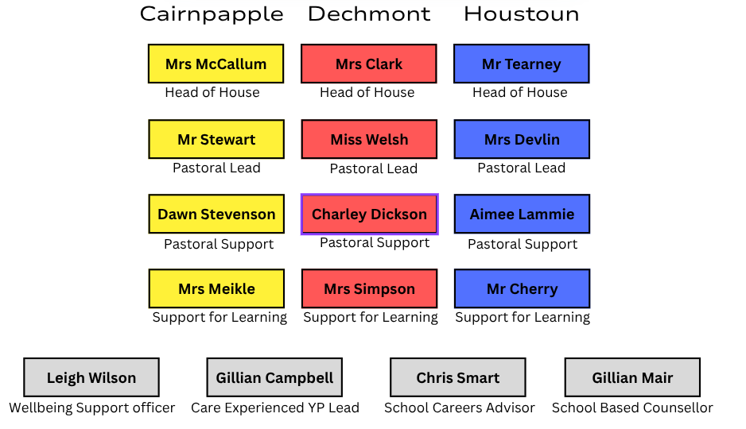
Who's who?
Miss Prentice
Anne Forbes

Slide 27
IMPORTANT INFO
Feel free to take a picture of the next slide :-)

Slide 28
Who to Contact?
If your child has an appointment, please contact PSA to let them know and we can mark attendance correctly.
For any pastoral related issues please contact PSA in the first instance, in most cases they will be able to help with your enquiry - If needed, they will pass on information to the HoH / PL / YH as required.
Please note that HoH and PL's have a large teaching commitment and cannot always respond straight away.
Please do not contact your child during school periods as mobiles should be away in classes and this causes a distraction for them. If you need to make urgent contact with your child, please phone PSA and they can do this for you.
Contact Details
Groupcall
07860049702
Email
wldch-psa@westlothian.org.uk
Main Line
01506 282155 option 2

Slide 29
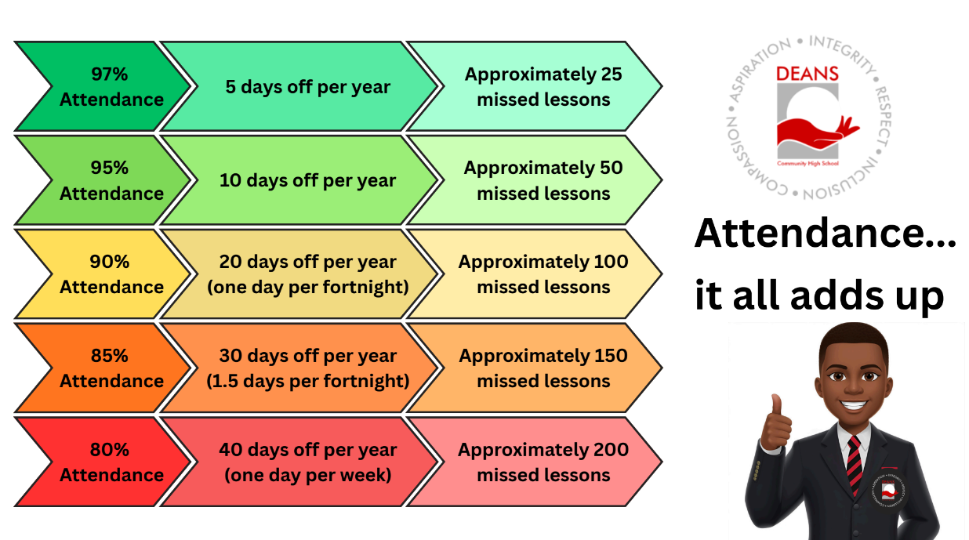

Slide 30
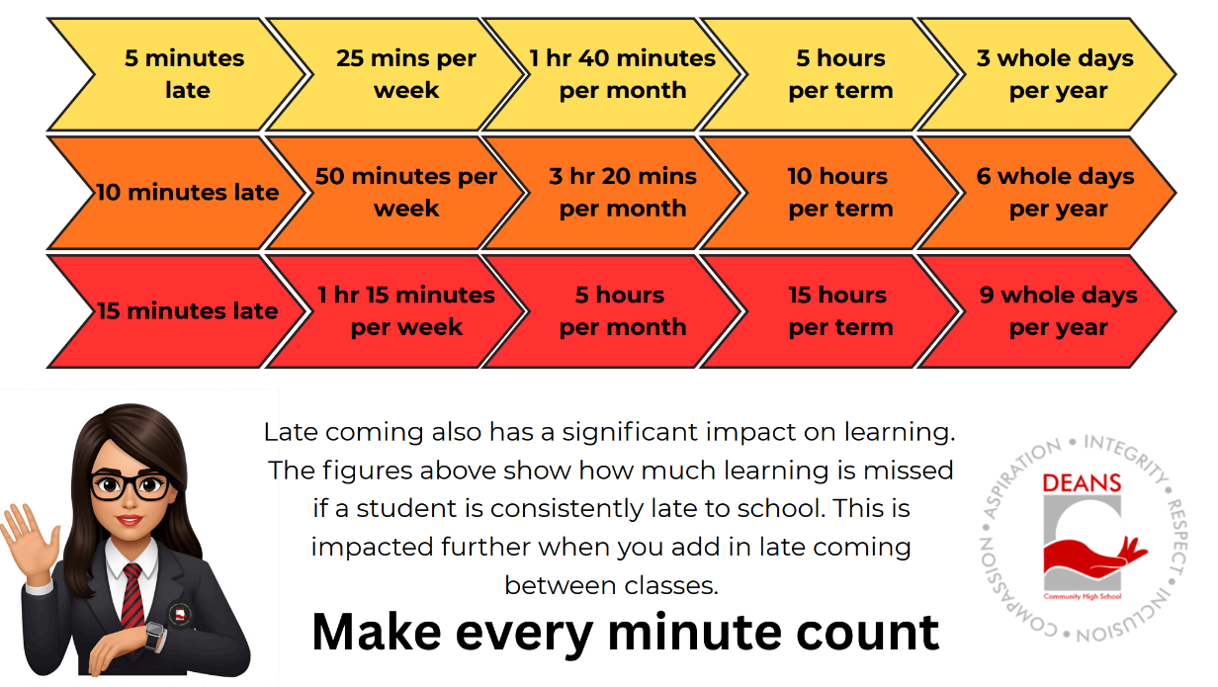

Slide 31

Mobile Phone Policy
Research shows that mobile phone can create significant
distraction and in turn can affect academic progress.
At Deans CHS we have a clear mobile phone policy
which was developed to encourage responsible device
use, and to support them to achieve their potential.
All students will be expected to store mobile phones in the class storage pouches on entering the classroom (this includes tutor).
On the rare occasion students need to contact home during class time, they should go to PSA who will make contact with home.
If you need to contact your child during class time, please contact PSA who will pass on a message.

Slide 32

What Can You Do To Help?
Value and promote education and attendance
Have structure, routines, boundaries
Keep holidays, evenings and weekends for family time wherever possible. Try and avoid booking holidays during school time.
Look for warning signs that there might be an issue – regular sore stomachs, headaches
Be aware of your child’s attendance/ lates data
Work in partnership with the school

Slide 33


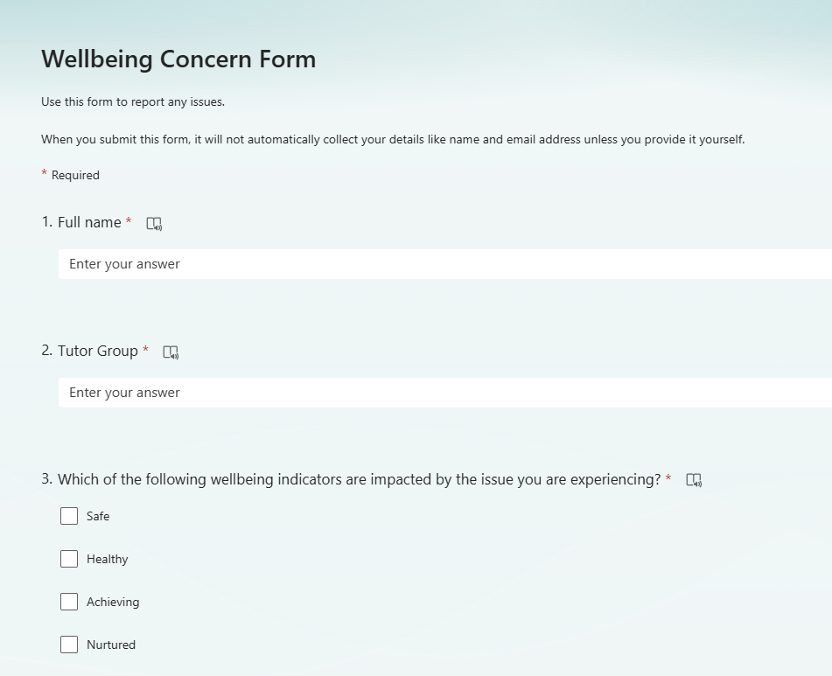
Concerns or Issues
What should you do?
Pupils - Speak to PSA/HoH/PL to report an incident straight away
Parents - contact PSA to make us aware of any situations arising.

Slide 34


Support Available
FYPAS link – Dianne McIvor
Dianne works closely with families to support financial wellbeing.
Regular updates shared through weekly parent newsletter
School Uniform Support​
We have an excellent relationship with the School Bank West Lothian. ​
If anyone is worried about the costs relating to uniform, please speak to the primary school, or email Miss Thomson.

Slide 35


Slide 36


