Slide 1

Deans Community High School
Course Choice Information 2026-27

Slide 2
Progression Route
S4
S5
S6
National 4 SCQF Level 4
National 5 SCQF Level 5
Higher
SCQF Level 6
National 5 SCQF Level 5
Higher
SCQF Level 6
Advanced Higher
SCQF Level 7
National 5 SCQF Level 5
National 4 SCQF Level 4
National 3
SCQF Level 3
Get to know the SCQF:
Know Your SCQF Level - Scottish Credit and Qualifications Framework

Slide 3
S1 – S2 Students | S3 Students
All S1 and S2 pupils experience a Broad General Education (BGE) which is organised into 8 categories. Expressive Arts Health and Wellbeing Languages Mathematics Religious and Moral Education Science Social Studies Technologies | All S3 students will study: Maths English
 | Pupils will choose 6 further subjects Pupils will study 8 subjects in total
 | In addition, all pupils will undertake: 2 periods a week of PE 1 period of RME 1 period of PSE

Slide 4
S4 Students | S5 Students | S6 Students
All S4 students will study English and Maths | Undertake 5 certificated courses from column options making progression from their S4 subjects | Undertake a minimum of 4 certificated courses
Students will be asked to indicate a first and second choice of subject to drop from the subjects they studied in S3. Pupils will study 7 qualifications | All pupils will take part in the core programme of Moral and Personal Education and PE | Students are advised to take only one advanced higher with a maximum of two
 |  | All pupils will take part in the core programme of Moral and Personal Education and PE
Some students may undertake a Skills for Work or West Lothian College Course following recommendation from their Head of House. | Opportunities to work with younger students: • After-school clubs • Music events • Sports teams • Student Council • Art events | Opportunity to look at studying additional qualifications virtually
 |  | S6 prefects’ school community involvement: • S6 Yearbook • S6 Prom • Charity and fund-raising work • Student Council

Slide 5
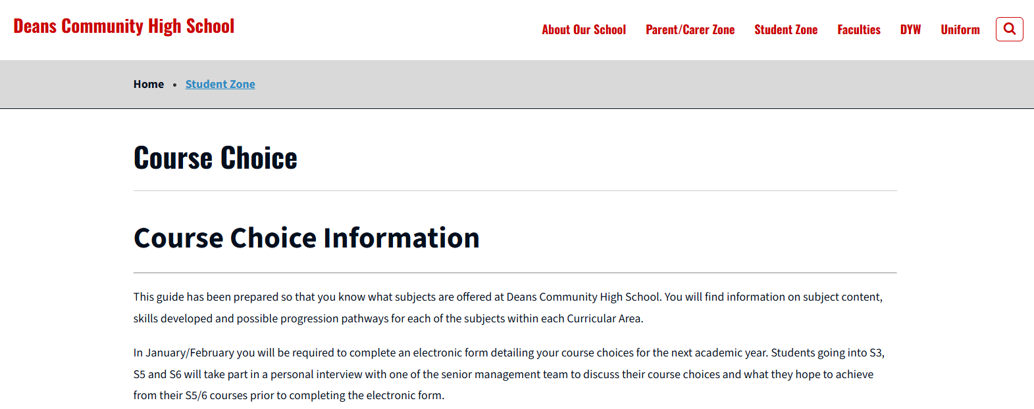
The link below will take you to the information on the school website.
Course Choice and Subject Pathways - Deans Community High School

Slide 6
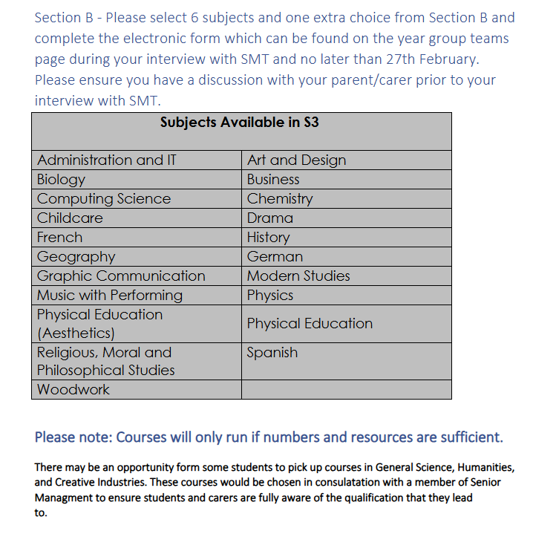

Slide 7


Slide 8




When making your choices
Choose
Subjects that you find enjoyable / interesting
Subjects that you are making good progress in
Think about your future – possible areas of interest, opportunity for careers
Do not Pick Subjects all from one Curriculum Area. Employers, Colleges and Universities want to see a Wide Skill Set.
Do Not Choose because
your friends are choosing That Subject
You like the teacher

Slide 9


Slide 10
What happens now?
Information will be shared via the year group TEAMs page and will be sent out to all parents and carers.
For selection of subject and levels. The electronic course choice form can be found on the student's year group TEAMs page.
Nearer the end of February students currently in S2, S4 and S5 will have an individual interview with a member of the Senior Management Team
If you cannot access the information, please contact Mrs Fleming by email
dawn.fleming@westlothian.org.uk
Latest Deadline returning for course choice online form completion:
  For S2 into S3 - Friday 27th February.
  For S3 into S4 - Friday 30th January.
  For S4 into S5 and S5 into S6 - Friday 27th February.

Slide 11
For more information
Please email dawn.fleming@westlothian.org.uk

