Slide 1

Welcome to
Deans Community High School

Slide 2

What I will share this evening...
The journey of Deans Community High School​
Curriculum Overview
Extra-curricular offer
Support at DCHS
Key staff
P7 Transition

Slide 3
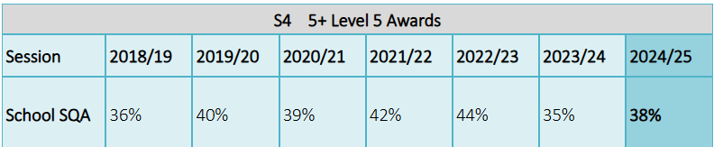
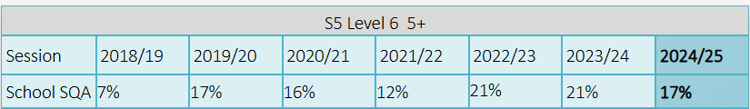
This year for SQA attainment we were in the top 6 schools in WL
Significant improvement in some areas – some departments performing above national average.
Aspirational presentation for SQA exams.

Slide 4
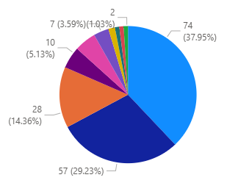
Higher Education
Further Education
Ful-time Employment
Currently 94% of our
2025 leavers have gone
on to a positive destination.

Slide 5
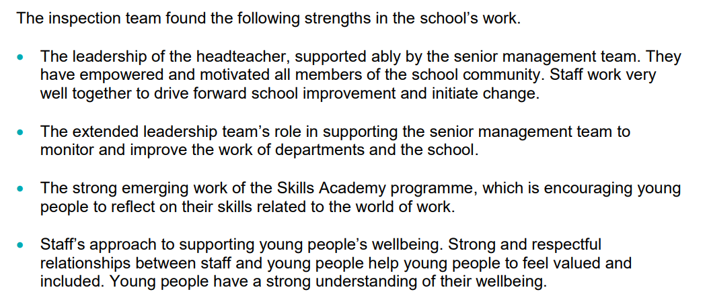
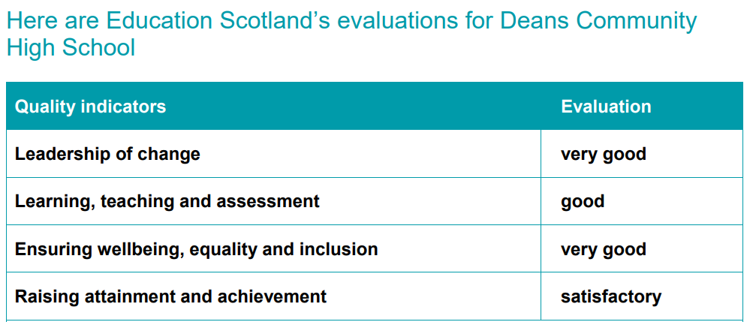

Slide 6


This year we celebrated the hard work of the school community in promoting the UNCRC Rights of the Child when we were awarded the GOLD award.
We were also delighted to be recognised for our work on encouraging young people to read with the SILVER award.

Slide 7
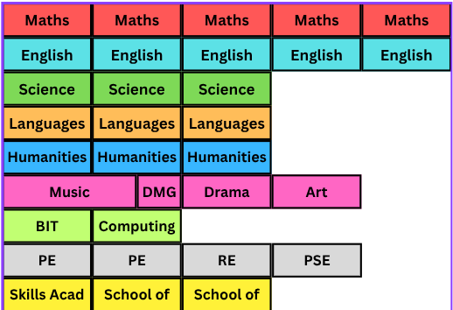
BGE Curriculum
The week is split into 32 periods
Each period is 50 minutes long (with the exception of P4)
Music – 1.5 periods per week
DMG – 0.5 periods per week
Core subjects PE/RE/PSE.

Slide 8

Skills Academy
This program takes place in 6-week blocks covering topics such as forensics, media and money management.
It is designed to develop skills such as communication, collaboration, teamwork and leadership. These are important across the school and into post-school destinations.
Pupils are supported to identify skills and discuss how they use them.

Slide 9

School of...
  Football
  Netball
  Dance
  Media
  School of Culture & Conversation
  School of Hospitality
  Philosophy
  Drama

Slide 10
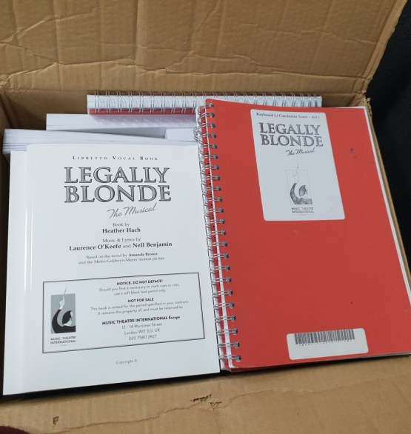
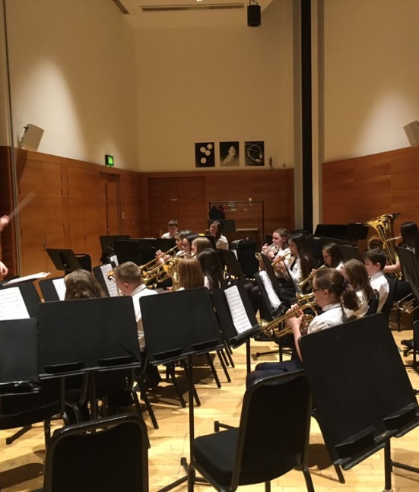
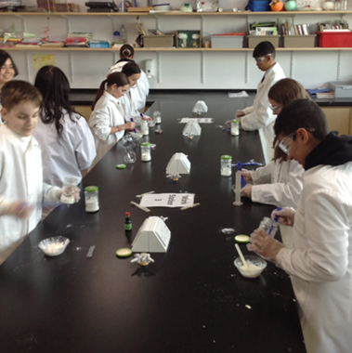
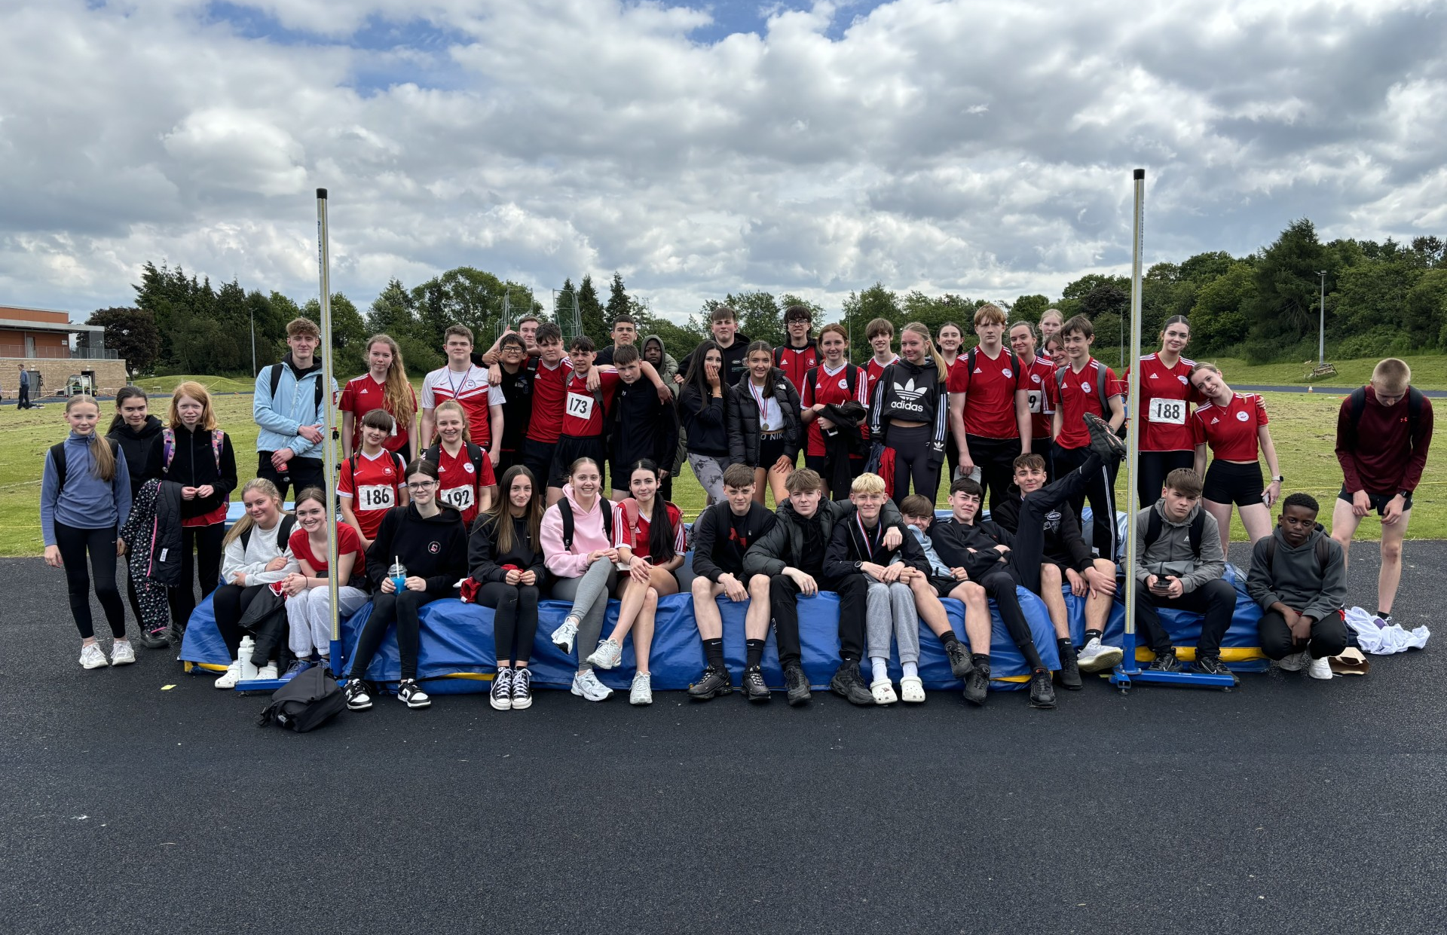
Extra-Curricular
The wider experience is a huge part of school life at DCHS with opportunities such as:
School bands
Sports activities including sportathon
School shows and musicals
Science fair and Science club
Activities week
Leadership opportunities

Slide 11
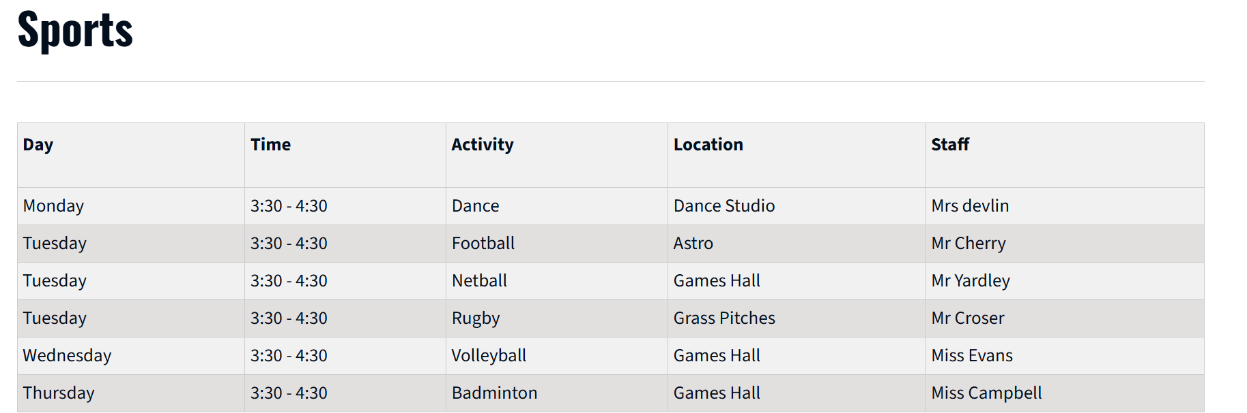
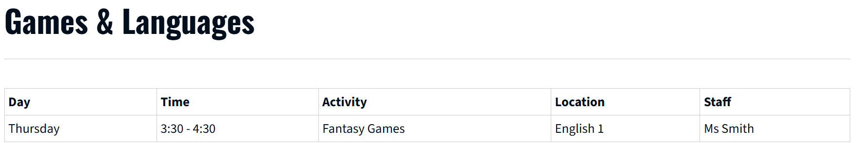

Slide 12
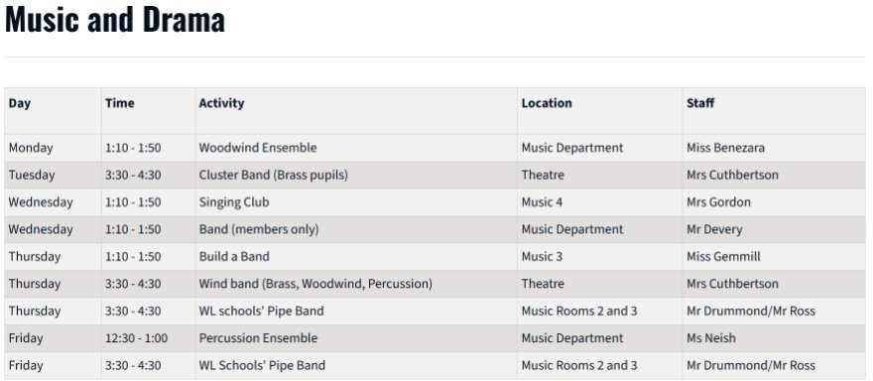

Slide 13
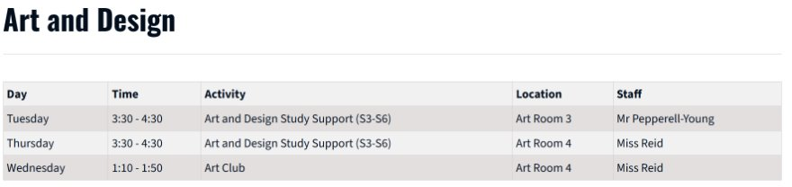
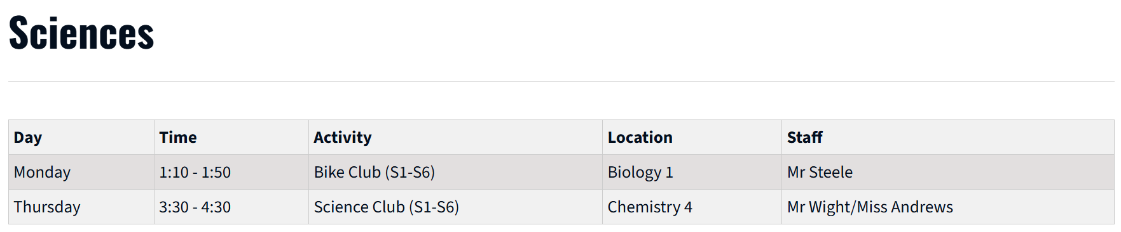

Slide 14
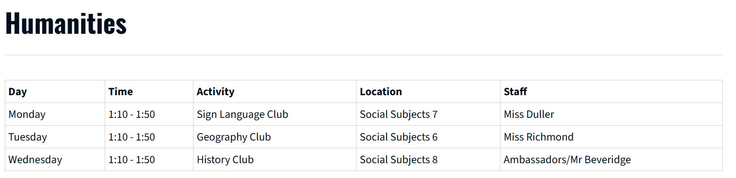
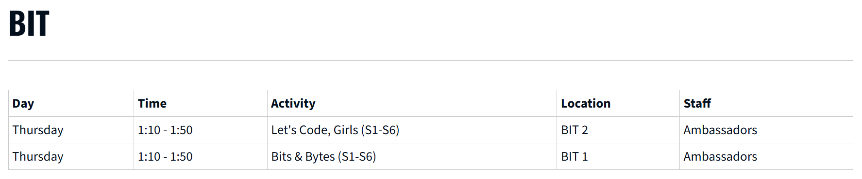

Slide 15

Support at Deans Community High School
Positive relationships are key.
Follow WL policy – including for positive
relationships and attendance.
Open and honest communication.
House system allows consistency.
Inclusive practice in every classroom.
Pupil support hub to share information.

Slide 16
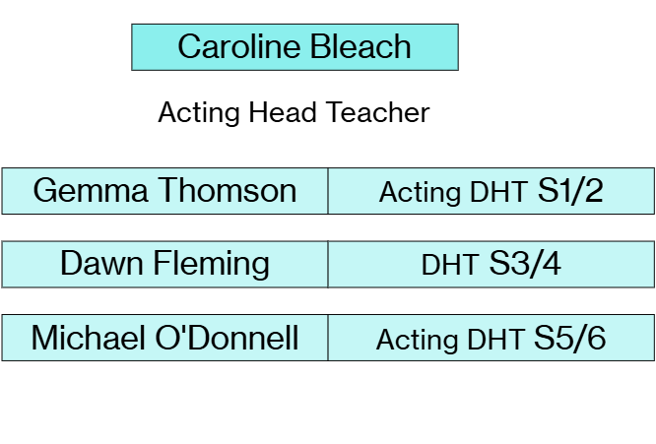
Who's who?

Slide 17
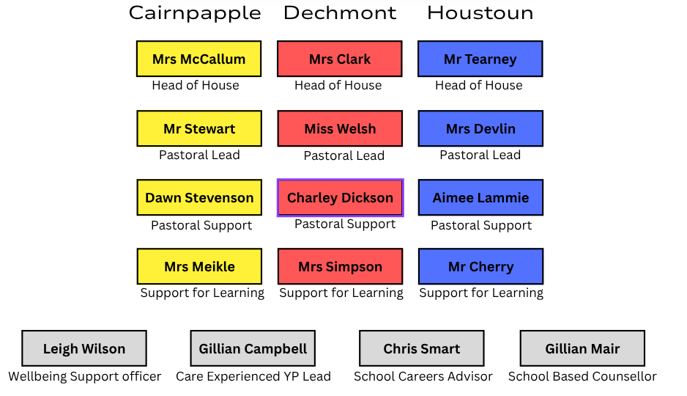
Who's who?
Ms Prentice

Slide 18

P7 Transition this year
Humanities – online session
  3rd Nov ~ 8th Dec
Languages – online session
  5th Jan ~ 2nd Feb
Maths – online session
  16th Feb ~ 23rd Mar
English – online session
  20th Apr ~ 25th May

Slide 19

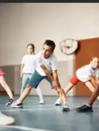

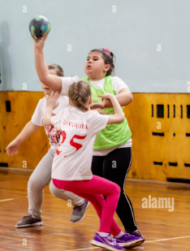
Other experiences

Slide 20

Transition Visits
9th/10th/11th of June
Monday – in primary (preparation for Tuesday). Timetables delivered and transition booklets collected.
Tuesday – come to school with their primary.
P1 in the theatre then follow normal timetable.
Wednesday – come to school on their own.
Follow normal timetable
Thursday – come to school on their own.
Follow normal timetable.
Friday – at primary

Slide 21
Any Questions? we will be around to chat for a while

